Slide 1
OHDSI Tutorial: Learning The PLP Framework
Youjin Park

Slide 2
You can access to the whole stuff at
https://github.com/ ohdsi-korea/ OhdsiKoreaTutorials

Slide 3
Prediction Process
Notes:
Show time/cross sectional plots

Slide 4
Prediction Process : 1. Labeled data
What is our labeled data?
Notes:
Show time/cross sectional plots

Slide 5




Our Data
We have longitudinal data but we need labelled data for prediction…
Disease
Treatment
Outcome
Person ID | Concept ID | Date
1 | 343 | 2016-01-01
1 | 12045 | 2016-01-12
1 | 88466 | 2017-04-05
…
1 | 0945 | 2019-01-23
2 | 343 | 2010-12-03
2 | 635636 | 2010-12-03
2 | 543 | 2010-12-05
…
Conditions
Drugs
Procedures
Measurements
Notes:
Show time/cross sectional plots

Slide 6
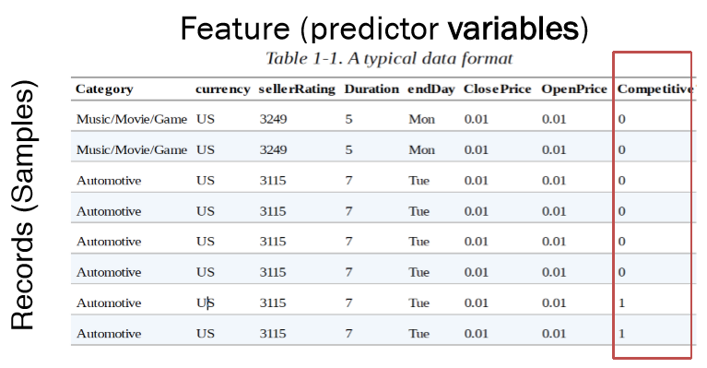
Labeled data
Longitudinal data have to be converted into
Rectangular data

Slide 7
Defining Prediction Problem
You need a well defined and clear prediction problem
Considerations:
Is this clinically useful?
Is there a clear timepoint to apply the model?

Slide 8
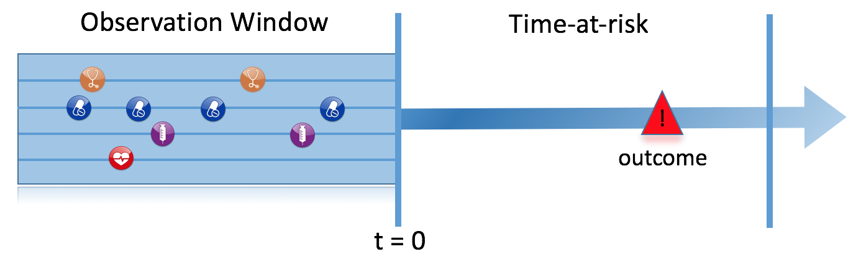
Prediction Problem Definition
In <target population>, predict who develop <outcome> during <time-at-risk>
Choice | Value
Target population | 예측을 하고자 하는 대상 환자군
Outcome | 예측하고자 하는 임상적인 결과
Time At Risk (TAR) | 예측 모델을 적용시키고자 하는 환자군에게서 예측하고자 하는 임상 결과를 관찰 할 시간 구간
Among a target population (T), we aim to predict which patients at a defined moment in time (t=0) will experience some outcome (O) during a time-at-risk Prediction is done using only information about the patients in an observation window prior to that moment in time.

Slide 9
Extracting Labelled Data
The target cohort is key because we need an index date to pivot on… Data before index are used as features and data after index are used to see whether outcome occurs during TAR
Disease
Treatment
Outcome
Conditions
Drugs
Procedures
Measurements
Person time
Baseline time
Follow-up time
0
Notes:
Show time/cross sectional plots

Slide 10
Defining Prediction Problem
Index
outcome
Conditions
Drugs
Procedures
Measurements
Person time
Baseline time
Follow-up time
0
Time at risk
Subject_id | Cohort start date | Has outcome during TAR
3454102 | 2012-01-02 | 1 (Yes)
105454 | 2012-08-12 | 0 (No)
… |  | …

Slide 11
Covariate setting
Index
outcome
Conditions
Drugs
Procedures
Measurements
Person time
Baseline time
Follow-up time
0
Time at risk
Subject_id | Condition A | Condition B | … | Drug N | Has outcome during TAR
3454102 | 1 | 1 | … | 0 | 1 (Yes)
105454 | 1 | 0 | … | 1 | 0 (No)
… | … | … | … | … | …

Slide 12
Covariates
Can pick three time periods and anytime prior to index (include index is an option)
Binary indicator variables for conditions, drugs, procedures, measurements and observations
Values for measurements
Can use hierarchy to create binary indicators for a code and all children code (grouped covariates)
Includes record type counts
Includes some common risk scores
Can add custom variables
Notes:
Examples here…

Slide 13
Population Settings
We have extra inclusion settings in the framework
Do you want to remove people who have the outcome prior (i.e., predict new occurrence of outcome)?
Do you want to only include each person in the target population once?
Do you want a minimum prior observation time (i.e., only include subjects with 3 years or prior records)?
How do you want to deal with people who are lost to follow-up?

Slide 14
Population Settings
We have extra inclusion settings in the framework
Do you want to remove people who have the outcome prior (i.e., predict new occurrence of outcome)?
Do you want to only include each person in the target population once?
Do you want a minimum prior observation time (i.e., only include subjects with 3 years or prior records)?
How do you want to deal with people who are lost to follow-up?

Slide 15
Imaging your cohort looks like this:
Subject_id | Cohort_id | Cohort_start_date | Outcome during TAR | Prior outcome
3454102 | 1 | 2012-01-02 | 0
105454 | 1 | 2012-08-12 | 0
1554 | 1 | 2009-05-05 | 0
56566 | 1 | 2011-07-05 | 0 | Yes (-35 days and -999 days)
4346356 | 1 | 2011-07-05 | 1
342424 | 1 | 2010-01-01 | 1 | Yes (-370 days)
… | … | …

Slide 16
Imaging your cohort looks like this:
Subject_id | Cohort_id | Cohort_start_date | Outcome during TAR | Prior outcome
3454102 | 1 | 2012-01-02 | 0
105454 | 1 | 2012-08-12 | 0
1554 | 1 | 2009-05-05 | 0
56566 | 1 | 2011-07-05 | 0 | Yes (-35 days and -999 days)
4346356 | 1 | 2011-07-05 | 1
342424 | 1 | 2010-01-01 | 1 | Yes (-370 days)
… | … | …
Remove patients who have observed the outcome prior to cohort entry? [YES]
How many days to look back from cohort entry for the outcome? [99999] days prior to cohort start

Slide 17
Imaging your cohort looks like this:
Subject_id | Cohort_id | Cohort_start_date | Outcome during TAR | Prior outcome
3454102 | 1 | 2012-01-02 | 0
105454 | 1 | 2012-08-12 | 0
1554 | 1 | 2009-05-05 | 0
56566 | 1 | 2011-07-05 | 0 | Yes (-35 days and -999 days)
4346356 | 1 | 2011-07-05 | 1
342424 | 1 | 2010-01-01 | 1 | Yes (-370 days)
… | … | …
Remove patients who have observed the outcome prior to cohort entry? [YES]
How many days to look back from cohort entry for the outcome? [365] days prior to cohort start

Slide 18
Population Settings
We have extra inclusion settings in the framework
Do you want to remove people who have the outcome prior (i.e., predict new occurrence of outcome)?
Do you want to only include each person in the target population once?
Do you want a minimum prior observation time (i.e., only include subjects with 3 years or prior records)?
How do you want to deal with people who are lost to follow-up?

Slide 19
Imaging your cohort looks like this:
Subject_id | Cohort_id | Cohort_start_date | Outcome during TAR
3454102 | 1 | 2012-01-02 | 0
105454 | 1 | 2012-08-12 | 0
105454 | 1 | 2013-10-04 | 0
1554 | 1 | 2009-05-05 | 0
56566 | 1 | 2011-07-05 | 0
4346356 | 1 | 2011-07-05 | 1
342424 | 1 | 2010-01-01 | 1
… | … | …

Slide 20
Imaging your cohort looks like this:
Subject_id | Cohort_id | Cohort_start_date | Outcome during TAR
3454102 | 1 | 2012-01-02 | 0
105454 | 1 | 2012-08-12 | 0
105454 | 1 | 2013-10-04 | 0
1554 | 1 | 2009-05-05 | 0
56566 | 1 | 2011-07-05 | 0
4346356 | 1 | 2011-07-05 | 1
342424 | 1 | 2010-01-01 | 1
… | … | …
Should only the first exposure per subject be included? [YES]

Slide 21
Imaging your cohort looks like this:
Subject_id | Cohort_id | Cohort_start_date | Outcome during TAR
3454102 | 1 | 2012-01-02 | 0
105454 | 1 | 2012-08-12 | 0
105454 | 1 | 2013-10-04 | 0
1554 | 1 | 2009-05-05 | 0
56566 | 1 | 2011-07-05 | 0
4346356 | 1 | 2011-07-05 | 1
342424 | 1 | 2010-01-01 | 1
… | … | …
Should only the first exposure per subject be included? [No]

Slide 22
Population Settings
We have extra inclusion settings in the framework
Do you want to remove people who have the outcome prior (i.e., predict new occurrence of outcome)?
Do you want to only include each person in the target population once?
Do you want a minimum prior observation time (i.e., only include subjects with 3 years or prior records)?
How do you want to deal with people who are lost to follow-up?

Slide 23
Imaging your cohort looks like this:
Subject_id | Cohort_id | Cohort_start_date | Outcome during TAR | Prior observation
3454102 | 1 | 2012-01-02 | 0 | 366
105454 | 1 | 2012-08-12 | 0 | 2009
1554 | 1 | 2009-05-05 | 0 | 1098
56566 | 1 | 2011-07-05 | 0 | 365
4346356 | 1 | 2011-07-05 | 1 | 4056
342424 | 1 | 2010-01-01 | 1 | 588
… | … | …

Slide 24
Imaging your cohort looks like this:
Subject_id | Cohort_id | Cohort_start_date | Outcome during TAR | Prior observation
3454102 | 1 | 2012-01-02 | 0 | 366
105454 | 1 | 2012-08-12 | 0 | 2009
1554 | 1 | 2009-05-05 | 0 | 1098
56566 | 1 | 2011-07-05 | 0 | 365
4346356 | 1 | 2011-07-05 | 1 | 4056
342424 | 1 | 2010-01-01 | 1 | 588
… | … | …
Minimum lookback period applied to target cohort: [730]

Slide 25
Imaging your cohort looks like this:
Subject_id | Cohort_id | Cohort_start_date | Outcome during TAR | Prior observation
3454102 | 1 | 2012-01-02 | 0 | 366
105454 | 1 | 2012-08-12 | 0 | 2009
1554 | 1 | 2009-05-05 | 0 | 1098
56566 | 1 | 2011-07-05 | 0 | 365
4346356 | 1 | 2011-07-05 | 1 | 4056
342424 | 1 | 2010-01-01 | 1 | 588
… | … | …
Minimum lookback period applied to target cohort: [1200]

Slide 26
Imaging your cohort looks like this:
Subject_id | Cohort_id | Cohort_start_date | Outcome during TAR | Prior observation
3454102 | 1 | 2012-01-02 | 0 | 366
105454 | 1 | 2012-08-12 | 0 | 2009
1554 | 1 | 2009-05-05 | 0 | 1098
56566 | 1 | 2011-07-05 | 0 | 365
4346356 | 1 | 2011-07-05 | 1 | 4056
342424 | 1 | 2010-01-01 | 1 | 588
… | … | …
Minimum lookback period applied to target cohort: [365]

Slide 27
Population Settings
We have extra inclusion settings in the framework
Do you want to remove people who have the outcome prior (i.e., predict new occurrence of outcome)?
Do you want to only include each person in the target population once?
Do you want a minimum prior observation time (i.e., only include subjects with 3 years or prior records)?
How do you want to deal with people who are lost to follow-up?

Slide 28
Imaging your cohort looks like this:
TAR (time-at-risk) is 1 day to 365 days after cohort start date
Subject_id | Cohort_id | Cohort_start_date | Outcome during TAR | Follow-up observation
3454102 | 1 | 2012-01-02 | 0 | 50
105454 | 1 | 2012-08-12 | 0 | 1082
1554 | 1 | 2009-05-05 | 0 | 366
56566 | 1 | 2011-07-05 | 0 | 480
4346356 | 1 | 2011-07-05 | 1 | 40
342424 | 1 | 2010-01-01 | 1 | 500
… | … | …

Slide 29
Imaging your cohort looks like this:
TAR (time-at-risk) is 1 day to 365 days after cohort start date
Subject_id | Cohort_id | Cohort_start_date | Outcome during TAR | Follow-up observation
3454102 | 1 | 2012-01-02 | 0 | 50
105454 | 1 | 2012-08-12 | 0 | 1082
1554 | 1 | 2009-05-05 | 0 | 366
56566 | 1 | 2011-07-05 | 0 | 480
4346356 | 1 | 2011-07-05 | 1 | 40
342424 | 1 | 2010-01-01 | 1 | 500
… | … | …
Should subjects without time at risk be removed? [YES]
Minimum time at risk: [364] days
Include people with outcomes who are not observed for the whole at risk period? [NO]

Slide 30
Imaging your cohort looks like this:
TAR (time-at-risk) is 1 day to 365 days after cohort start date
Subject_id | Cohort_id | Cohort_start_date | Outcome during TAR | Follow-up observation
3454102 | 1 | 2012-01-02 | 0 | 50
105454 | 1 | 2012-08-12 | 0 | 1082
1554 | 1 | 2009-05-05 | 0 | 366
56566 | 1 | 2011-07-05 | 0 | 480
4346356 | 1 | 2011-07-05 | 1 | 40
342424 | 1 | 2010-01-01 | 1 | 500
… | … | …
Should subjects without time at risk be removed? [YES]
Minimum time at risk: [364] days
Include people with outcomes who are not observed for the whole at risk period? [YES]

Slide 31
Imaging your cohort looks like this:
TAR (time-at-risk) is 1 day to 365 days after cohort start date
Subject_id | Cohort_id | Cohort_start_date | Outcome during TAR | Follow-up observation
3454102 | 1 | 2012-01-02 | 0 | 50
105454 | 1 | 2012-08-12 | 0 | 1082
1554 | 1 | 2009-05-05 | 0 | 366
56566 | 1 | 2011-07-05 | 0 | 480
4346356 | 1 | 2011-07-05 | 1 | 40
342424 | 1 | 2010-01-01 | 1 | 500
… | … | …
Should subjects without time at risk be removed? [No]
Minimum time at risk: [1] days
Include people with outcomes who are not observed for the whole at risk period? [No]

Slide 32
Summary
define prediction problem
specify covariate settings
specify population settings – this modifies target population and creates labels
Notes:
Show time/cross sectional plots

Slide 33
My problem is..
In clopidogrel new users, predict who develop gastrointestinal bleeding within 1 year after starting clopidogrel
Choice | Value
Target population | Clopidogrel new users
Outcome | Gastrointestinal bleeding
Time At Risk (TAR) | From 1 day to 365 days after index date

Slide 34
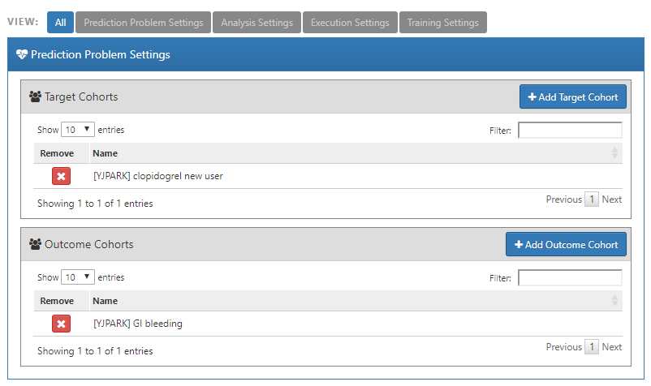
Prediction problem settings

Slide 35
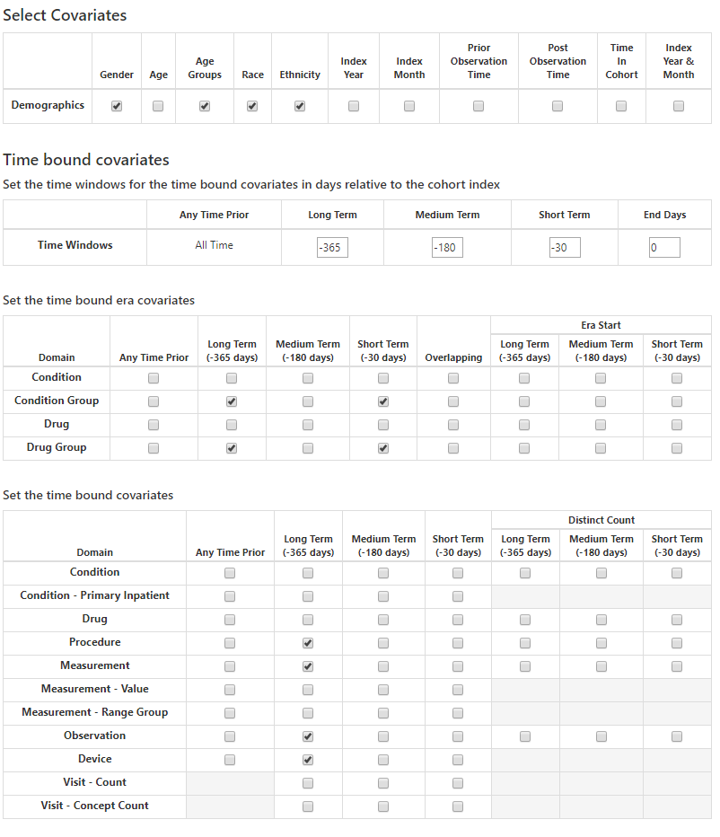
Covariate Settings

Slide 36
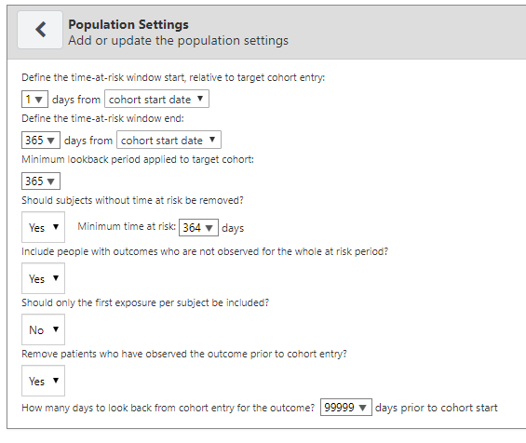
Population settings
Time at risk setting
Minimum time at risk setting

Slide 37
Population settings
Outcome prior to cohort start

Slide 38
Prediction Process : 2. Model development settings
Model Development Settings
Notes:
Show time/cross sectional plots

Slide 39
Train/Test Data Settings
Train/Test %
e.g., 75/25
Split Seed
e.g., 1
Split type
e.g., time or person
Notes:
Add visulistion of time split vs random split

Slide 40
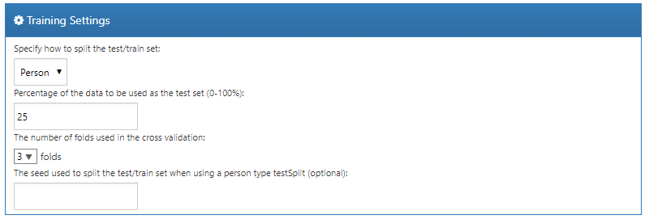
Train/Test Data Settings

Slide 41
Training Classifier
Learns to map covariates to class
Effectively about learning a decision boundary that partitions the two classes
Different classifiers lead to different decisions boundaries

Slide 42
Training Settings
Select the machine learning models that will be trained
Define the hyper-parameter search strategy

Slide 43








Library of classifiers built in

Slide 44
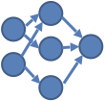
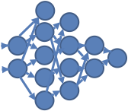
What are hyper-parameters?
They control the complexity of a model
E.g., if we wanted to fit a neural network the topology of the network defines the complexity of the model (few layers and a small number of nodes = more simple)

Slide 45
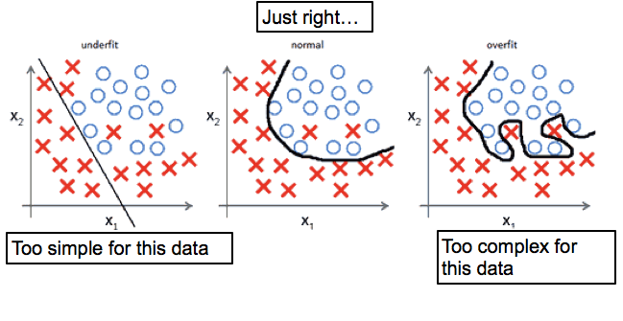
Over vs Under fitting

Slide 46
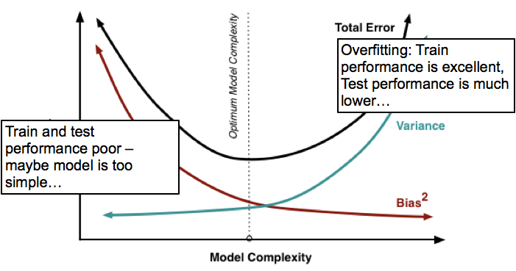
Over vs Under fitting

Slide 47
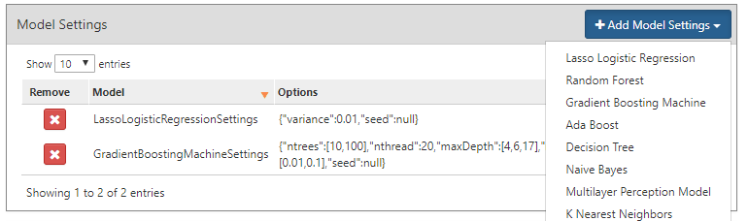
Model settings

Slide 48
Summary:
We suggest trying multiple classifiers
We have default hyper-parameter grid searches but you can expand this
Data has to be divided into train and test set

Slide 49
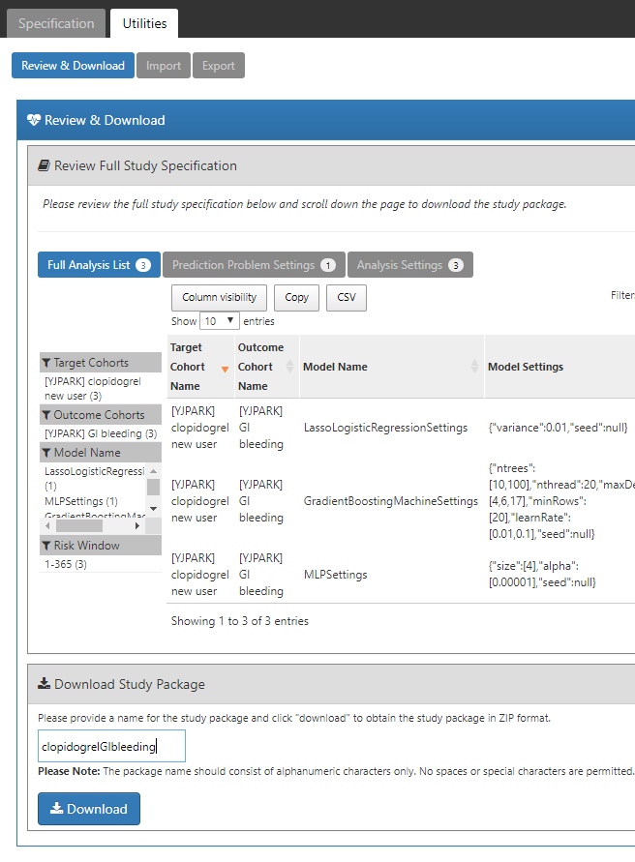

Prediction Process : 3. Execute prediction in R
Name the package and click ‘Download’ in the Utilities tab
Notes:
Show time/cross sectional plots

Slide 50
How to install?
Build and run in R-Studio
Open package
Own machine: unzip, double-click .Rproj file
R-Studio Server: upload zip, click .Rproj file
Install dependencies (see readme)
‘Build’, ‘Install and Restart”
Build from GitHub
Unzip and put in GitHub repo
Install dependencies (see readme)
Install with devtools::install_github

Slide 51

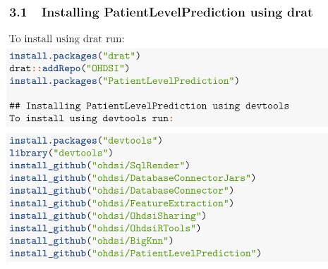
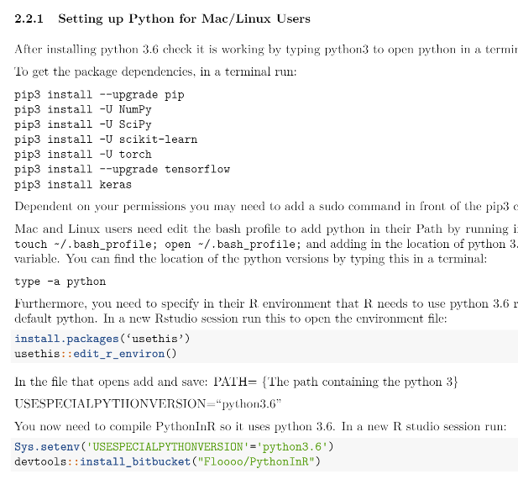
Install dependencies
https://github.com/OHDSI/PatientLevelPrediction/blob/master/inst/doc/InstallationGuide.pdf

Slide 52
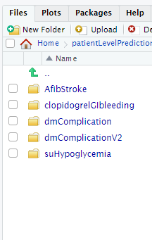
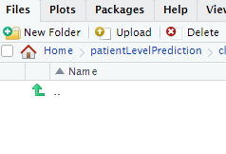
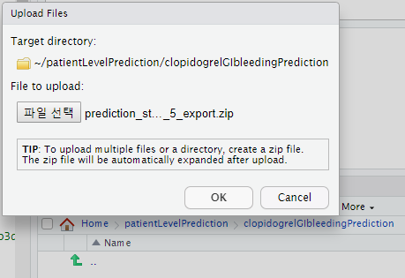
Running package 1. Upload package
1. Make a new folder
2. Get in the new folder and click upload
3. Upload the zip.file which downloaded before

Slide 53
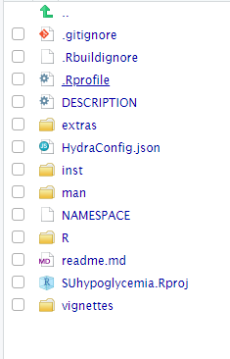
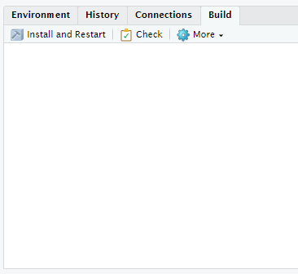
Running package 2. Install and Restart
4. Get in the new folder and click upload
5. Install and Restart

Slide 54
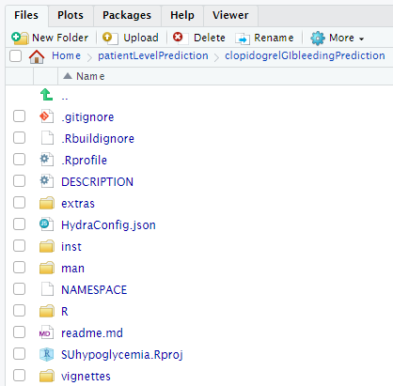
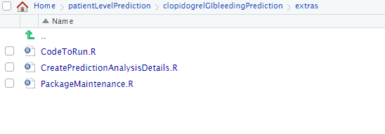
Running package 3. CodeToRun.R

Slide 55
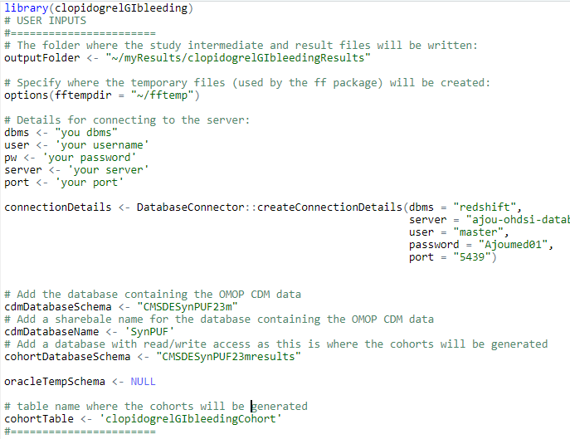
Running package 3. CodeToRun.R

Slide 56
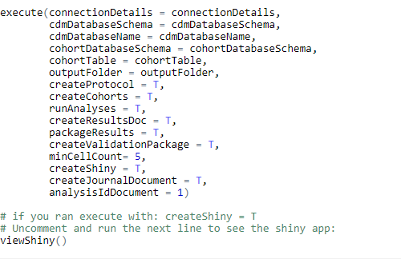
Running package 3. CodeToRun.R

Slide 57
Prediction Process : 4. Model evaluation
Model Evaluation
Notes:
Show time/cross sectional plots

Slide 58
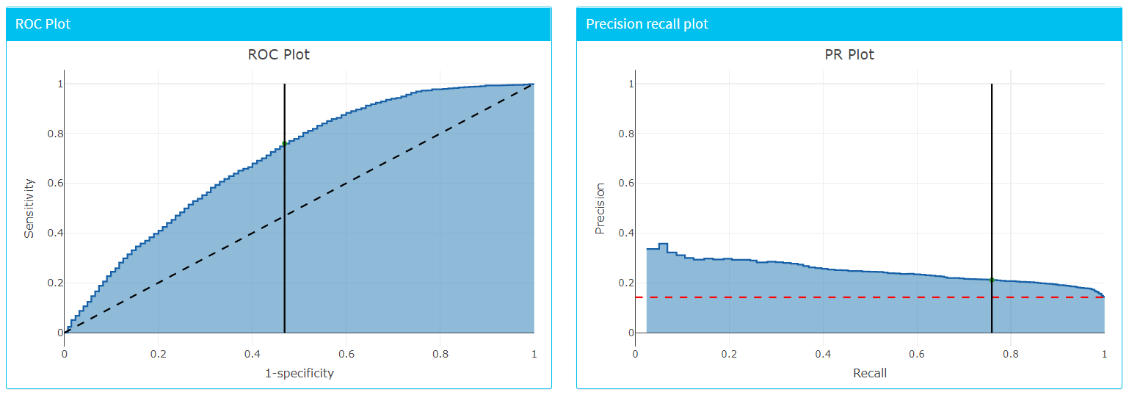
Metrics/Plots

Slide 59
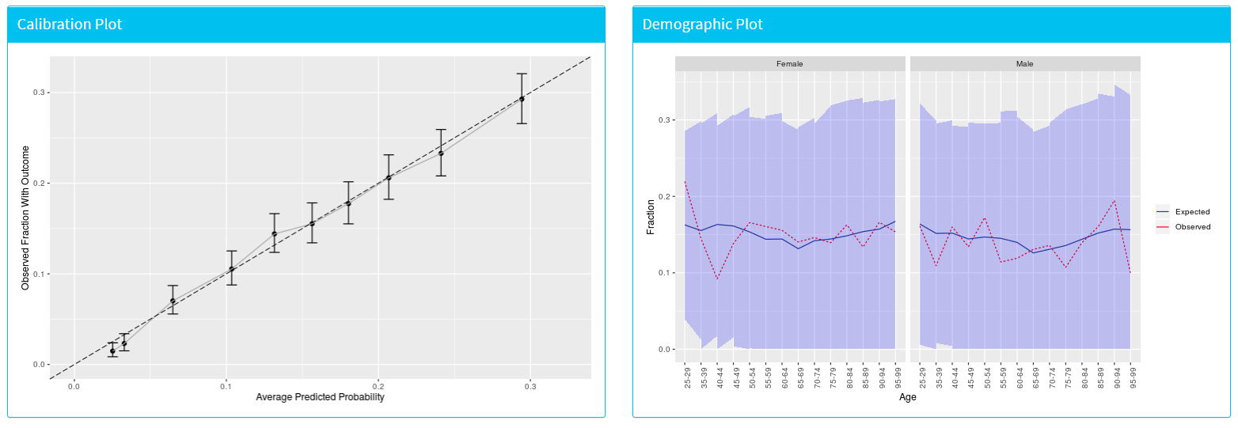
View Interactively via Shiny

Slide 60
https://youjinpark.shinyapps.io/PLPViewer/

Slide 61
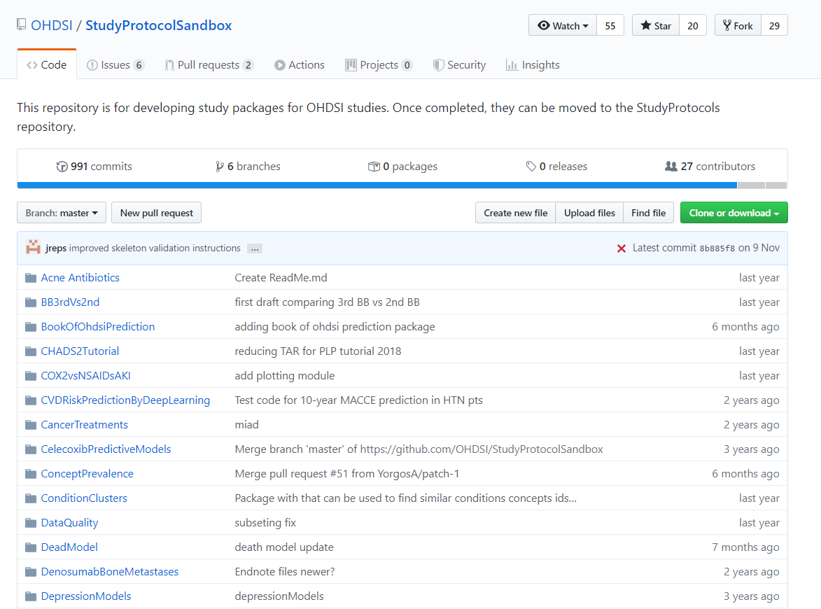
OHDSI study protocol sandbox
https://github.com/OHDSI/StudyProtocolSandbox

Slide 62
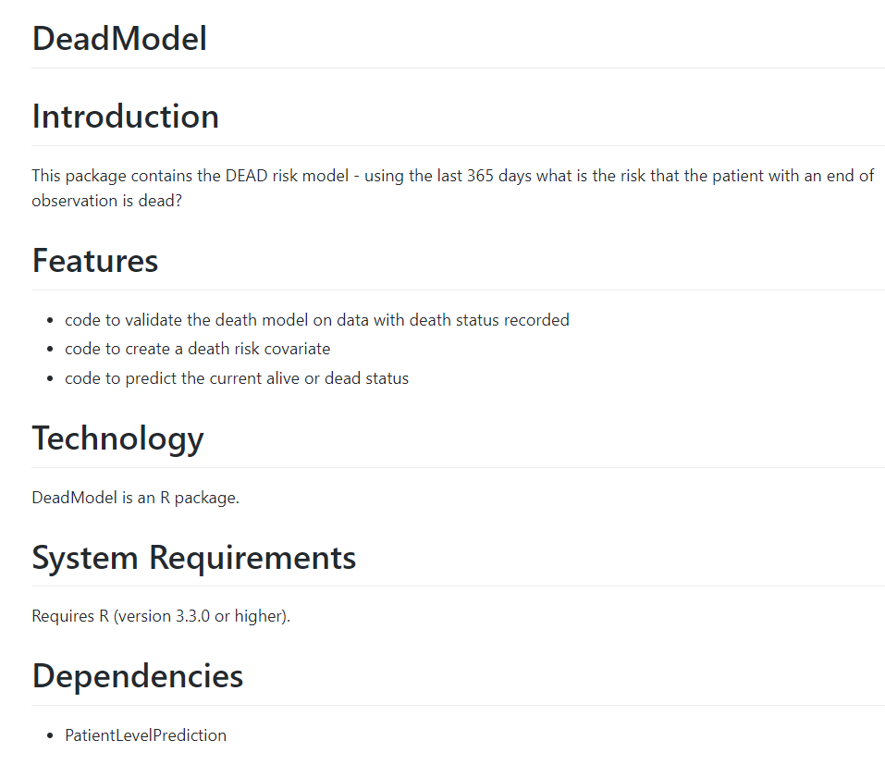
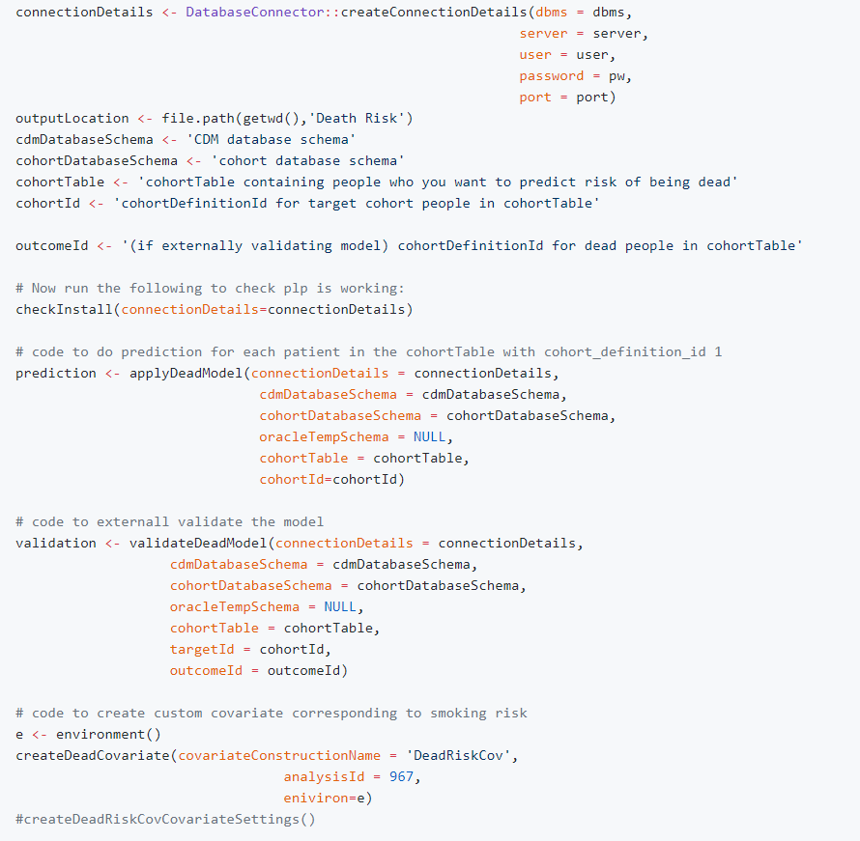
OHDSI study protocol sandbox
https://github.com/OHDSI/StudyProtocolSandbox/tree/master/DeadModel

Slide 63
Selection of prediction problem
Youjin Park

Slide 64
Prediction Problem Definition
Among a target population (T), we aim to predict which patients at a defined moment in time (t=0) will experience some outcome (O) during a time-at-risk Prediction is done using only information about the patients in an observation window prior to that moment in time.

Slide 65
What are the key inputs to a patient-level prediction study?
Input parameter | Design choice
Target cohort (T)
Outcome cohort (O)
Time-at-risk
Model development -which algorithm(s)? -which parameters? -which covariates?
We extract data for the patients in the Target Cohort (T) of which some will experience the outcome (O) in T
T
O

Slide 66
Types of prediction problems in healthcare
Type | Structure | Example
Disease onset and progression | Amongst patients who are newly diagnosed with <insert your favorite disease>, which patients will go on to have <another disease or related complication> within <time horizon from diagnosis>? | Among newly diagnosed AFib patients, which will go onto to have ischemic stroke in next 3 years?
Treatment choice | Amongst patients with <indicated disease> who are treated with either <treatment 1> or <treatment 2>, which patients were treated with <treatment 1> (on day 0)? | Among AFib patients who took either warfarin or rivaroxaban, which patients got warfarin? (as defined for propensity score model)
Treatment response | Amongst patients who are new users of <insert your favorite chronically-used drug>, which patients will <insert desired effect> in <time window>? | Which patients with T2DM who start on metformin stay on metformin after 3 years?
Treatment safety | Amongst patients who are new users of <insert your favorite drug>, which patients will experience <insert your favorite known adverse event from the drug profile> within <time horizon following exposure start>? | Among new users of warfarin, which patients will have GI bleed in 1 year?
Treatment adherence | Amongst patients who are new users of <insert your favorite chronically-used drug>, which patients will achieve <adherence metric threshold> at <time horizon>? | Which patients with T2DM who start on metformin achieve >=80% proportion of days covered at 1 year?

Slide 67
Types of prediction problems in healthcare
Type | Structure | Example
Disease onset and progression | Amongst patients who are newly diagnosed with <insert your favorite disease>, which patients will go on to have <another disease or related complication> within <time horizon from diagnosis>? | Among newly diagnosed AFib patients, which will go onto to have ischemic stroke in next 3 years?
Treatment choice | Amongst patients with <indicated disease> who are treated with either <treatment 1> or <treatment 2>, which patients were treated with <treatment 1> (on day 0)? | Among AFib patients who took either warfarin or rivaroxaban, which patients got warfarin? (as defined for propensity score model)
Treatment response | Amongst patients who are new users of <insert your favorite chronically-used drug>, which patients will <insert desired effect> in <time window>? | Which patients with T2DM who start on metformin stay on metformin after 3 years?
Treatment safety | Amongst patients who are new users of <insert your favorite drug>, which patients will experience <insert your favorite known adverse event from the drug profile> within <time horizon following exposure start>? | Among new users of warfarin, which patients will have GI bleed in 1 year?
Treatment adherence | Amongst patients who are new users of <insert your favorite chronically-used drug>, which patients will achieve <adherence metric threshold> at <time horizon>? | Which patients with T2DM who start on metformin achieve >=80% proportion of days covered at 1 year?
Type | Structure
Disease onset and progression | Amongst patients who are newly diagnosed with <insert your favorite disease>, which patients will go on to have <another disease or related complication> within <time horizon from diagnosis>? Among newly diagnosed AFib patients, which will go onto to have ischemic stroke in next 3 years?

Slide 68
Types of prediction problems in healthcare
Type | Structure | Example
Disease onset and progression | Amongst patients who are newly diagnosed with <insert your favorite disease>, which patients will go on to have <another disease or related complication> within <time horizon from diagnosis>? | Among newly diagnosed AFib patients, which will go onto to have ischemic stroke in next 3 years?
Treatment choice | Amongst patients with <indicated disease> who are treated with either <treatment 1> or <treatment 2>, which patients were treated with <treatment 1> (on day 0)? | Among AFib patients who took either warfarin or rivaroxaban, which patients got warfarin? (as defined for propensity score model)
Treatment response | Amongst patients who are new users of <insert your favorite chronically-used drug>, which patients will <insert desired effect> in <time window>? | Which patients with T2DM who start on metformin stay on metformin after 3 years?
Treatment safety | Amongst patients who are new users of <insert your favorite drug>, which patients will experience <insert your favorite known adverse event from the drug profile> within <time horizon following exposure start>? | Among new users of warfarin, which patients will have GI bleed in 1 year?
Treatment adherence | Amongst patients who are new users of <insert your favorite chronically-used drug>, which patients will achieve <adherence metric threshold> at <time horizon>? | Which patients with T2DM who start on metformin achieve >=80% proportion of days covered at 1 year?
Type | Structure
Treatment choice | Amongst patients with <indicated disease> who are treated with either <treatment 1> or <treatment 2>, which patients were treated with <treatment 1> (on day 0)? Among AFib patients who took either warfarin or rivaroxaban, which patients got warfarin? (as defined for propensity score model)

Slide 69
Types of prediction problems in healthcare
Type | Structure | Example
Disease onset and progression | Amongst patients who are newly diagnosed with <insert your favorite disease>, which patients will go on to have <another disease or related complication> within <time horizon from diagnosis>? | Among newly diagnosed AFib patients, which will go onto to have ischemic stroke in next 3 years?
Treatment choice | Amongst patients with <indicated disease> who are treated with either <treatment 1> or <treatment 2>, which patients were treated with <treatment 1> (on day 0)? | Among AFib patients who took either warfarin or rivaroxaban, which patients got warfarin? (as defined for propensity score model)
Treatment response | Amongst patients who are new users of <insert your favorite chronically-used drug>, which patients will <insert desired effect> in <time window>? | Which patients with T2DM who start on metformin stay on metformin after 3 years?
Treatment safety | Amongst patients who are new users of <insert your favorite drug>, which patients will experience <insert your favorite known adverse event from the drug profile> within <time horizon following exposure start>? | Among new users of warfarin, which patients will have GI bleed in 1 year?
Treatment adherence | Amongst patients who are new users of <insert your favorite chronically-used drug>, which patients will achieve <adherence metric threshold> at <time horizon>? | Which patients with T2DM who start on metformin achieve >=80% proportion of days covered at 1 year?
Type | Structure
Treatment response | Amongst patients who are new users of <insert your favorite chronically-used drug>, which patients will <insert desired effect> in <time window>? Which patients with T2DM who start on metformin stay on metformin after 3 years?

Slide 70
Types of prediction problems in healthcare
Type | Structure | Example
Disease onset and progression | Amongst patients who are newly diagnosed with <insert your favorite disease>, which patients will go on to have <another disease or related complication> within <time horizon from diagnosis>? | Among newly diagnosed AFib patients, which will go onto to have ischemic stroke in next 3 years?
Treatment choice | Amongst patients with <indicated disease> who are treated with either <treatment 1> or <treatment 2>, which patients were treated with <treatment 1> (on day 0)? | Among AFib patients who took either warfarin or rivaroxaban, which patients got warfarin? (as defined for propensity score model)
Treatment response | Amongst patients who are new users of <insert your favorite chronically-used drug>, which patients will <insert desired effect> in <time window>? | Which patients with T2DM who start on metformin stay on metformin after 3 years?
Treatment safety | Amongst patients who are new users of <insert your favorite drug>, which patients will experience <insert your favorite known adverse event from the drug profile> within <time horizon following exposure start>? | Among new users of warfarin, which patients will have GI bleed in 1 year?
Treatment adherence | Amongst patients who are new users of <insert your favorite chronically-used drug>, which patients will achieve <adherence metric threshold> at <time horizon>? | Which patients with T2DM who start on metformin achieve >=80% proportion of days covered at 1 year?
Type | Structure
Treatment safety | Amongst patients who are new users of <insert your favorite drug>, which patients will experience <insert your favorite known adverse event from the drug profile> within <time horizon following exposure start>? Among new users of warfarin, which patients will have GI bleed in 1 year?

Slide 71
Types of prediction problems in healthcare
Type | Structure | Example
Disease onset and progression | Amongst patients who are newly diagnosed with <insert your favorite disease>, which patients will go on to have <another disease or related complication> within <time horizon from diagnosis>? | Among newly diagnosed AFib patients, which will go onto to have ischemic stroke in next 3 years?
Treatment choice | Amongst patients with <indicated disease> who are treated with either <treatment 1> or <treatment 2>, which patients were treated with <treatment 1> (on day 0)? | Among AFib patients who took either warfarin or rivaroxaban, which patients got warfarin? (as defined for propensity score model)
Treatment response | Amongst patients who are new users of <insert your favorite chronically-used drug>, which patients will <insert desired effect> in <time window>? | Which patients with T2DM who start on metformin stay on metformin after 3 years?
Treatment safety | Amongst patients who are new users of <insert your favorite drug>, which patients will experience <insert your favorite known adverse event from the drug profile> within <time horizon following exposure start>? | Among new users of warfarin, which patients will have GI bleed in 1 year?
Treatment adherence | Amongst patients who are new users of <insert your favorite chronically-used drug>, which patients will achieve <adherence metric threshold> at <time horizon>? | Which patients with T2DM who start on metformin achieve >=80% proportion of days covered at 1 year?
Type | Structure
Treatment adherence | Amongst patients who are new users of <insert your favorite chronically-used drug>, which patients will achieve <adherence metric threshold> at <time horizon>? Which patients with T2DM who start on metformin achieve >=80% proportion of days covered at 1 year?

Slide 72
Types of prediction problems in healthcare
Type | Structure | Example
Disease onset and progression | Amongst patients who are newly diagnosed with <insert your favorite disease>, which patients will go on to have <another disease or related complication> within <time horizon from diagnosis>? | Among newly diagnosed AFib patients, which will go onto to have ischemic stroke in next 3 years?
Treatment choice | Amongst patients with <indicated disease> who are treated with either <treatment 1> or <treatment 2>, which patients were treated with <treatment 1> (on day 0)? | Among AFib patients who took either warfarin or rivaroxaban, which patients got warfarin? (as defined for propensity score model)
Treatment response | Amongst patients who are new users of <insert your favorite chronically-used drug>, which patients will <insert desired effect> in <time window>? | Which patients with T2DM who start on metformin stay on metformin after 3 years?
Treatment safety | Amongst patients who are new users of <insert your favorite drug>, which patients will experience <insert your favorite known adverse event from the drug profile> within <time horizon following exposure start>? | Among new users of warfarin, which patients will have GI bleed in 1 year?
Treatment adherence | Amongst patients who are new users of <insert your favorite chronically-used drug>, which patients will achieve <adherence metric threshold> at <time horizon>? | Which patients with T2DM who start on metformin achieve >=80% proportion of days covered at 1 year?

Slide 73

Make a team and define your own prediction problem!
Choice | Value
Target population | 예측을 하고자 하는 대상 환자군
Outcome | 예측하고자 하는 임상적인 결과
Time At Risk (TAR) | 예측 모델을 적용시키고자 하는 환자군에게서 예측하고자 하는 임상 결과를 관찰 할 시간 구간
2019 OHDSI
PATIENT LEVEL PREDICTION
OPEN CHAT TALK

